Slide 1

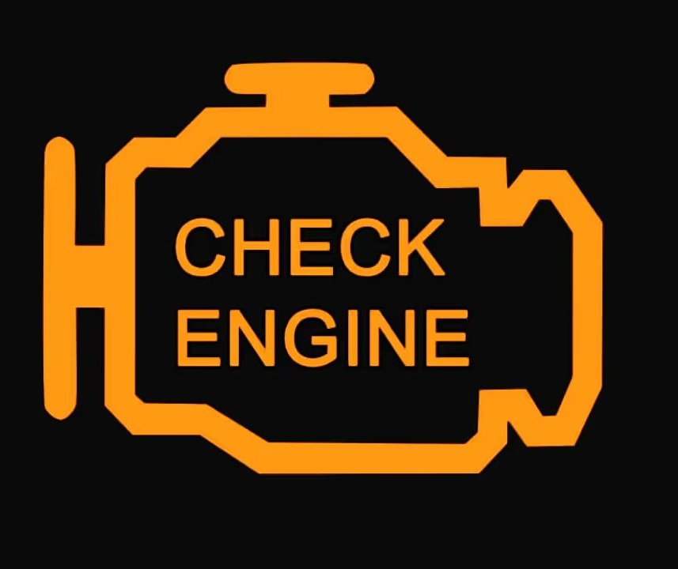

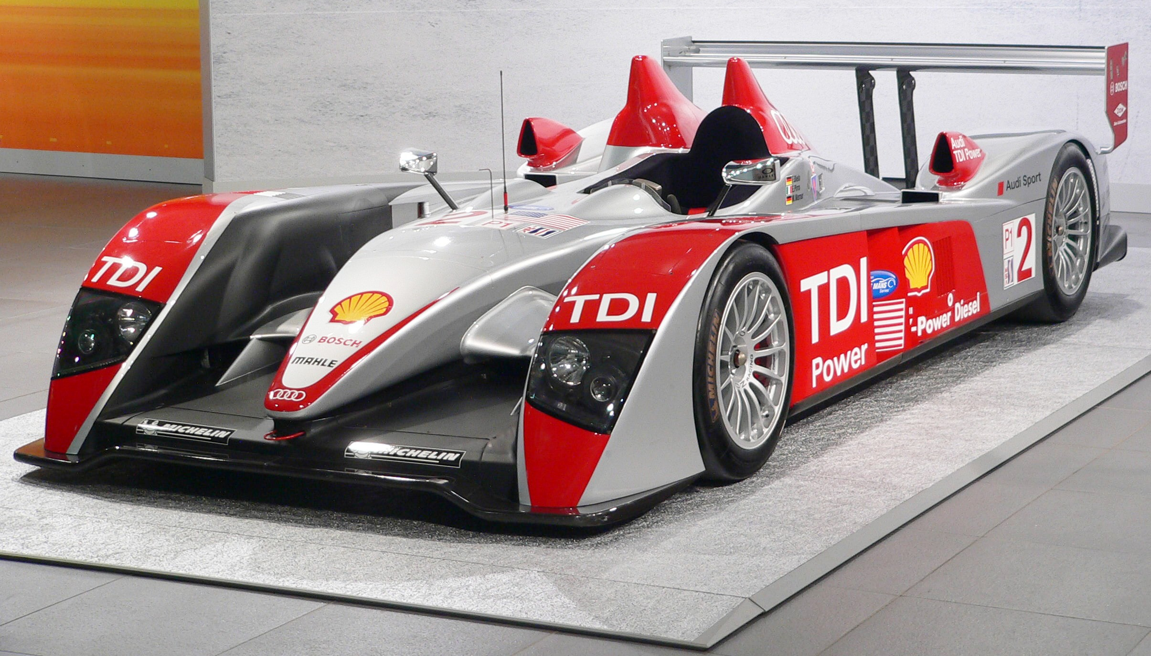
Fun car stuff
Nikita Borodins
P2915170

Slide 2
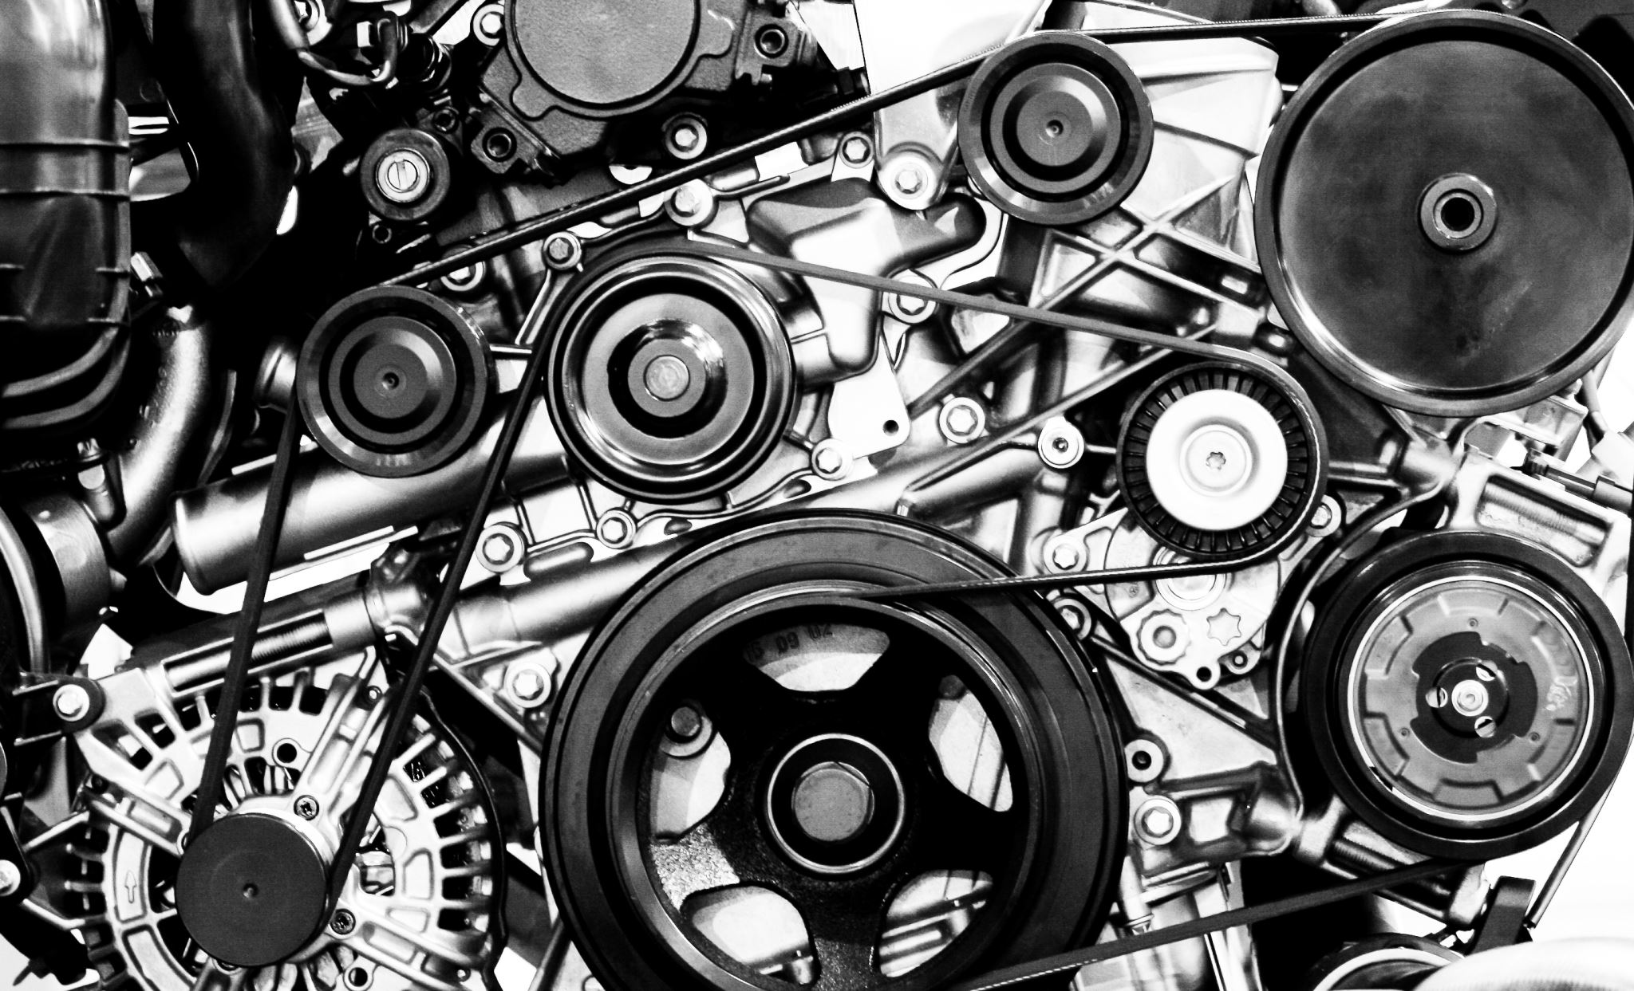
Engine
Source of propulsion for the car
Energy is gained by detonating an air/fuel mixture
Different types of engine, we are going to be looking at traditional internal combustion ☺

Slide 3
Combustion
The flame front will reach the piston surface and apply pressure to it, generating torque.
If the flame front reaches the piston before it goes past TDC or just at TDC, that is called knock and that can damage the engine.
Knock prevention includes either increasing the amount of fuel added or making ignition timing later.
It is important that the flame front touches down on the piston some 10 degrees after TDC, otherwise it will stress the components
The flame front moves at the local speed of sound (defined by temperature, and the composition of the AFM) generally speaking, higher cylinder pressures lead to higher speed of sound
Intake
Intake valve opens to let in air from the intake manifold.
Downwards stroke of the piston creates a vacuum, sucking in air and fuel & mixing them in the combustion chamber
Air contains oxygen, which will react with the fuel to create a combustion reaction later on
Fuel is injected at the stage where valve opens for port injected engines.
For direct injected engines , fuel is injected a bit later
THIS IS NOT A DIESEL ENGINE
Valve closes when or just before the piston reaches bottom dead
Compression
During compression all the valves are closed
In the sealed chamber, the piston moves upwards to top dead center(TDC).
This compresses the air fuel mixture(AFM), pressurising and heating the AFM.This will make the combustion more powerful and efficient.
If the compression results in too hot of a mixture, premature detonation can occur, causing damage.
The spark plug may ignite the AFM before the piston reached TDC(NOTE TO SELF – EXPLAIN)
Exhaust
The exhaust valve opens and lets the leftover gases to escape, as they can no longer be used for combustion
The piston moves upwards and helps push the gases outwards.
When the piston reaches TDC, the exhaust valve closes and the chamber is once again sealed.
Intake happens again after this
Cheatsheet
AFM - Air Fuel Mixture
TDC - Top dead center
BDC - Bottom dead center

Slide 4
Things I did not talk about
Diesel engine mechanics
Fuel based cooling
Primary/secondary imbalance
Crankshaft, conrods
I didn’t talk about all of that because I would run out of time :)
Compression ratio
There is obviously much more to know!

Slide 5
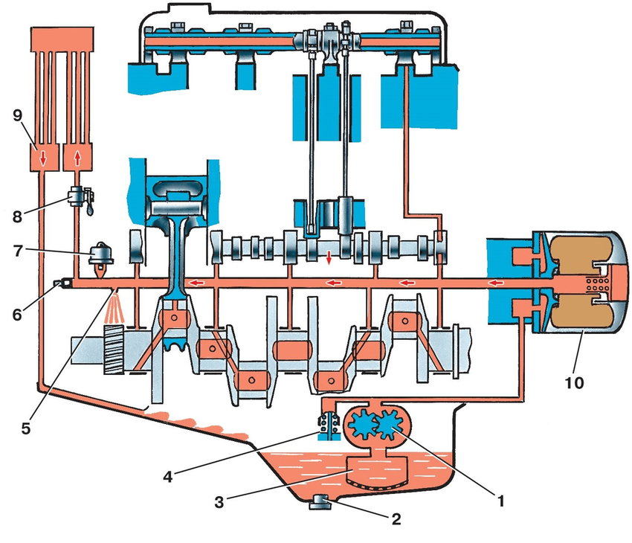
Cool, now some cool engine stuff.
Oil = lifeblood
Piston rings
Cross hatching
Oiling
Thrust bearings

Slide 6
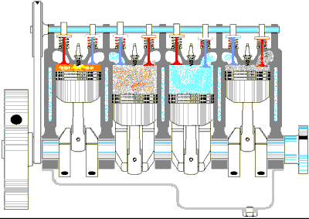
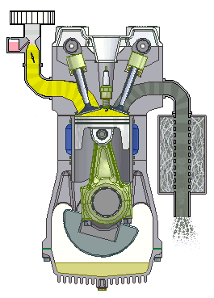

Slide 7
Question time
There is a lot to take in. If you have a question, ask it. If nobody wants to ask any questions, ask me what my favourite ice cream flavour is to break the ice (pun not intended).

